Slide 1
PROJECT STRONGBOX
Capitalizing on Security, Performance, and Energy Tradeoffs in Full Drive/Disk Encryption Schemes for Fun and Profit
BERNARD DICKENS III HENRY HOFFMANN HARYADI S. GUNAWI DAVID CASH ARIEL J. FELDMAN

Slide 2
STRONGBOX
StrongBox I
We update the conventional wisdom regarding FDE: stream ciphers are suitable for FDE!
We develop and implement a secure approach to FDE based on the ChaCha20 stream cipher, F2FS LFS, and RPMB eMMC trusted hardware

Slide 3
STRONGBOX
StrongBox I
We update the conventional wisdom regarding FDE: stream ciphers are suitable for FDE!
We develop and implement a secure approach to FDE based on the ChaCha20 stream cipher, F2FS LFS, and RPMB eMMC trusted hardware
StrongBox II
We consider the tradeoff space and motivated use cases formed between ciphers other than just ChaCha20 (e.g. Freestyle, Rabbit, AES-CTR)
Cipher characteristics we trade off include: energy use, system perf, and security guarantees of the cipher (e.g. key length, computation time, hardness)

Slide 4
STRONGBOX
StrongBox I
We update the conventional wisdom regarding FDE: stream ciphers are suitable for FDE!
We develop and implement a secure approach to FDE based on the ChaCha20 stream cipher, F2FS LFS, and RPMB eMMC trusted hardware
StrongBox II
We consider the tradeoff space and motivated use cases formed between ciphers other than just ChaCha20 (e.g. Freestyle, Rabbit, AES-CTR)
Cipher characteristics we trade off include: energy use, system perf, and security guarantees of the cipher (e.g. key length, computation time, hardness)
StrongBox III
We present a novel theoretical framework for FDE and formally evaluate the security guarantees of our constructions

Slide 5
STRONGBOX
StrongBox I
We update the conventional wisdom regarding FDE: stream ciphers are suitable for FDE!
We develop and implement a secure approach to FDE based on the ChaCha20 stream cipher, F2FS LFS, and RPMB eMMC trusted hardware
StrongBox II
We consider the tradeoff space and motivated use cases formed between ciphers other than just ChaCha20 (e.g. Freestyle, Rabbit, AES-CTR)
Cipher characteristics we trade off include: energy use, system perf, and security guarantees of the cipher (e.g. key length, computation time, hardness)
StrongBox III
We present a novel theoretical framework for FDE and formally evaluate the security guarantees of our constructions

Slide 6

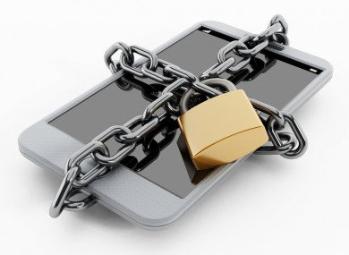

FULL DRIVE (DISK) ENCRYPTION?
STRONGBOX I

Slide 7
FULL DRIVE (DISK) ENCRYPTION?
Industry standard for FDE: AES-XTS
STRONGBOX I

Slide 8
AES BLOCK CIPHER IN XTS MODE
AES is a block cipher
STRONGBOX I

Slide 9

AES BLOCK CIPHER IN XTS MODE
AES is a block cipher
Inspired by traditional spinning disk storage
STRONGBOX I

Slide 10
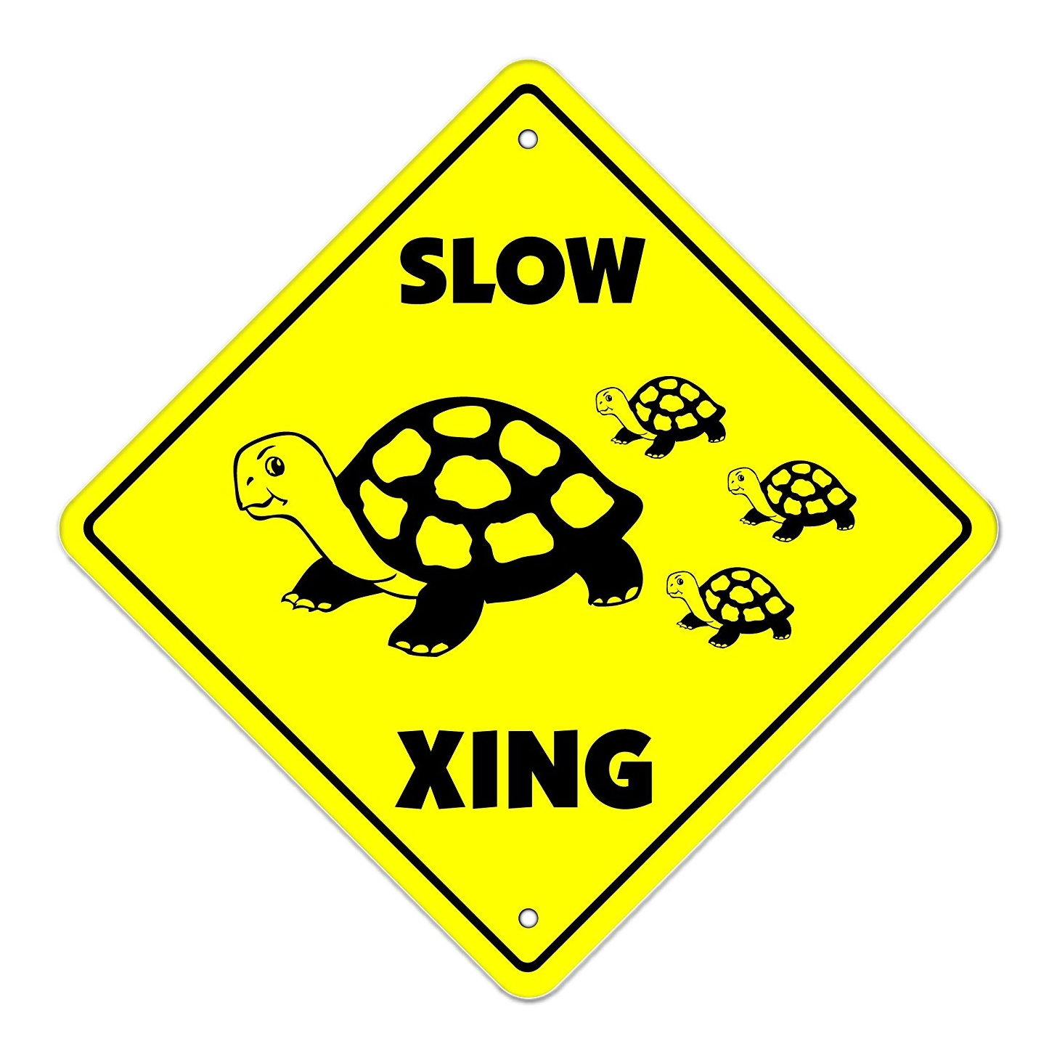
AES BLOCK CIPHER IN XTS MODE
AES is a block cipher
Inspired by traditional spinning disk storage
Problem: AES-XTS is SLOW
DATA
AES-XTS
DATA
DATA
STRONGBOX I

Slide 11
AES BLOCK CIPHER IN XTS MODE
AES is a block cipher
Inspired by traditional spinning disk storage
Problem: AES-XTS is SLOW
Cause: narrow AES “blocks,” wide disk sectors
DISK SECTOR
STRONGBOX I

Slide 12
AES BLOCK CIPHER IN XTS MODE
AES is a block cipher
Inspired by traditional spinning disk storage
Problem: AES-XTS is SLOW
Cause: narrow AES “blocks,” wide disk sectors
DISK SECTOR
STRONGBOX I

Slide 13
AES BLOCK CIPHER IN XTS MODE
AES is a block cipher
Inspired by traditional spinning disk storage
Problem: AES-XTS is SLOW
Cause: narrow AES “blocks,” wide disk sectors
DISK SECTOR
STRONGBOX I

Slide 14
AES BLOCK CIPHER IN XTS MODE
AES is a block cipher
Inspired by traditional spinning disk storage
Problem: AES-XTS is SLOW
Cause: narrow AES “blocks,” wide disk sectors
DISK SECTOR
STRONGBOX I

Slide 15
AES BLOCK CIPHER IN XTS MODE
AES is a block cipher
Inspired by traditional spinning disk storage
Problem: AES-XTS is SLOW
Cause: narrow AES “blocks,” wide disk sectors
DISK SECTOR
STRONGBOX I

Slide 16
AES BLOCK CIPHER IN XTS MODE
AES is a block cipher
Inspired by traditional spinning disk storage
Problem: AES-XTS is SLOW
Cause: narrow AES “blocks,” wide disk sectors
DISK SECTOR
FINALLY DONE!
STRONGBOX I

Slide 17
BLOCKS VERSUS STREAMS
Stream ciphers are also a thing
STRONGBOX I

Slide 18
BLOCKS VERSUS STREAMS
Stream ciphers are also a thing
Data encrypted via XOR as a continuous stream
Your Data:
1
1
1
0
0
1
0
0
⊕
Keystream:
0
1
0
0
1
1
0
1
=
Encrypted:
STRONGBOX I

Slide 19
BLOCKS VERSUS STREAMS
Stream ciphers are also a thing
Data encrypted via XOR as a continuous stream
Stream ciphers are FAST
Cause: XOR (ARX) operation is simple, fast
Your Data:
1
1
1
0
0
1
0
0
⊕
Keystream:
0
1
0
0
1
1
0
1
=
Encrypted:
STRONGBOX I

Slide 20
NOT THE ONLY CIPHER IN TOWN
There are many stream ciphers with various characteristics
STRONGBOX I

Slide 21
NOT THE ONLY CIPHER IN TOWN
There are many stream ciphers with various characteristics
High throughput ciphers
Sosemanuk and Rabbit
STRONGBOX I

Slide 22
NOT THE ONLY CIPHER IN TOWN
There are many stream ciphers with various characteristics
High throughput ciphers
Sosemanuk and Rabbit
Software/energy efficient ciphers
ChaCha and Salsa
STRONGBOX I

Slide 23
NOT THE ONLY CIPHER IN TOWN
There are many stream ciphers with various characteristics
High throughput ciphers
Sosemanuk and Rabbit
Software/energy efficient ciphers
ChaCha and Salsa
Tweakable overwrite-resistant ciphers
Freestyle
STRONGBOX I

Slide 24
NOT THE ONLY CIPHER IN TOWN
There are many stream ciphers with various characteristics
High throughput ciphers
Sosemanuk and Rabbit
Software/energy efficient ciphers
ChaCha and Salsa
Tweakable overwrite-resistant ciphers
Freestyle
Hardware-accelerated and other interesting ciphers
Reduced-round ChaCha (e.g. ARM Neon impl)
CTR mode block ciphers (e.g. AES-CTR)
STRONGBOX I

Slide 25

Switch Ciphers, Problem Solved?
STRONGBOX I

Slide 26
Big Problems with Stream Ciphers
There are two big problems with using stream ciphers for FDE:
STRONGBOX I

Slide 27
Big Problems with Stream Ciphers
There are two big problems with using stream ciphers for FDE:
Data confidentiality can be trivially violated with overwrites
STRONGBOX I

Slide 28
Big Problems with Stream Ciphers
There are two big problems with using stream ciphers for FDE:
Data confidentiality can be trivially violated with overwrites
Rolling back the system to a previously valid state also leads to confidentiality violations
STRONGBOX I

Slide 29
Overwrites Are a Big Deal
Why are overwrites such a problem?
Overwrites violate confidentiality
Rollbacks lead to overwrites

Slide 30


Overwrites Are a Big Deal
Why are overwrites such a problem?
Your Data:
Keystream:
Overwrites violate confidentiality
Rollbacks lead to overwrites

Slide 31


Overwrites Are a Big Deal
Why are overwrites such a problem?
Your Data:
⊕ =>
Keystream:
Encrypted
Overwrites violate confidentiality
Rollbacks lead to overwrites

Slide 32

Overwrites Are a Big Deal
Why are overwrites such a problem?
Your Data:
(the same)
Keystream:
Overwrites violate confidentiality
Rollbacks lead to overwrites

Slide 33


Overwrites Are a Big Deal
Why are overwrites such a problem?
Your Data:
⊕ =>
(the same)
Encrypted?
Keystream:
Overwrites violate confidentiality
Rollbacks lead to overwrites

Slide 34
Overwrites Are a Big Deal
Why are overwrites such a problem?
Original Write:
d’ ⊕ pad = c’
(i.e. same keystream)
Overwrite:
Overwrites violate confidentiality
Rollbacks lead to overwrites

Slide 35


Overwrites Are a Big Deal
Why are overwrites such a problem?
Original Write:
d’ ⊕ pad = c’
⊕ =>
(i.e. same keystream)
ENCRYPTION BROKEN!
Overwrite:
Overwrites violate confidentiality
Rollbacks lead to overwrites

Slide 36
Overwrites Are a Big Deal
Why are overwrites such a problem?
The solution: “rekey” the keystream on every overwrite
Overwrites violate confidentiality
Rollbacks lead to overwrites

Slide 37
Overwrites Are a Big Deal
Why are overwrites such a problem?
The solution: “rekey” the keystream on every overwrite
Another problem: rekeying is expensive!
Overwrites violate confidentiality
Rollbacks lead to overwrites

Slide 38
Overwrites Are a Big Deal
Why are overwrites such a problem?
The solution: “rekey” the keystream on every overwrite
Another problem: rekeying is expensive!
Out of ~17,000 write ops, EXT4 makes ~10,000 overwrites
10,000 x expensive operation = performance degradation
This expense negates perf benefit of the stream cipher
Overwrites violate confidentiality
Rollbacks lead to overwrites

Slide 39

ROLLBACKs Are Compromising
Rollbacks are even worse!
Overwrites violate confidentiality
Rollbacks lead to overwrites

Slide 40
ROLLBACKs Are Compromising
Rollbacks are even worse!
Take a snapshot of the system at valid state
Overwrites violate confidentiality
Rollbacks lead to overwrites

Slide 41
ROLLBACKs Are Compromising
Rollbacks are even worse!
Take a snapshot of the system at valid state
Rollback the system to a previous valid state
Overwrites violate confidentiality
Rollbacks lead to overwrites

Slide 42
ROLLBACKs Are Compromising
Rollbacks are even worse!
Take a snapshot of the system at valid state
Rollback the system to a previous valid state
Allow writes as normal
Overwrites violate confidentiality
Rollbacks lead to overwrites

Slide 43
ROLLBACKs Are Compromising
Rollbacks are even worse!
Take a snapshot of the system at valid state
Rollback the system to a previous valid state
Allow writes as normal
Contrast (XOR) encrypted snapshot with current “encrypted” state
SAME AS AN OVERWRITE!
Overwrites violate confidentiality
Rollbacks lead to overwrites

Slide 44

No!
You can only use
a block cipher for
Full Drive
Encryption!

Slide 45
The Old Assumption
Stream ciphers are faster…
… but the overhead of dealing with overwrites and rollbacks negates any potential perf benefit
Hence, AES-XTS is the industry standard
STRONGBOX I

Slide 46
the Old Assumption: Invalidated
Key insight: two technology trends invalidate old assumption
STRONGBOX I

Slide 47
the Old Assumption: Invalidated
Key insight: two technology trends invalidate old assumption
Non-volatile flash memory as secondary storage
Governed by Flash Translation Layer (FTL)
FTL tends to avoid overwriting same cells (wear-leveling)
STRONGBOX I

Slide 48
the Old Assumption: Invalidated
Key insight: two technology trends invalidate old assumption
Non-volatile flash memory as secondary storage
Governed by Flash Translation Layer (FTL)
FTL tends to avoid overwriting same cells (wear-leveling)
Proliferation of secure hardware
TPM/TEE implemented by nearly all computer and mobile device manufacturers
Secure hardware allows us to actively version system state and detect rollbacks
STRONGBOX I

Slide 49
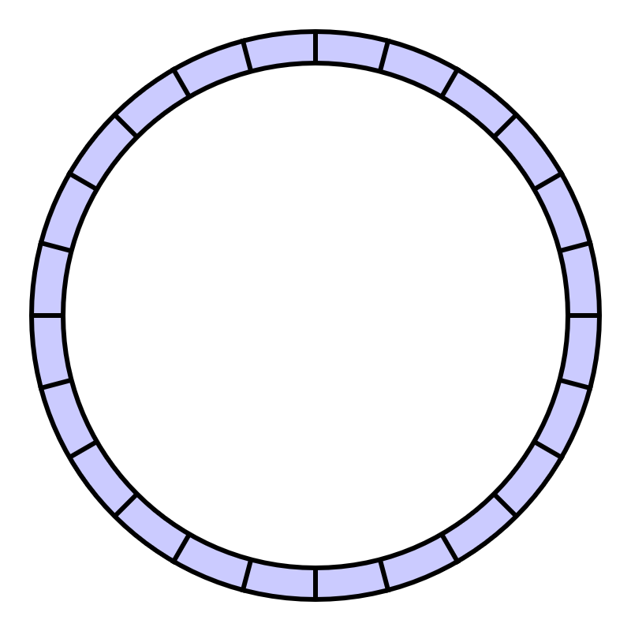
FTL <=> LFS
FTL operates like a Log-structured File System (LFS)
FTL = LFS = append-only writes
(naturally avoids overwrites)
STRONGBOX I

Slide 50
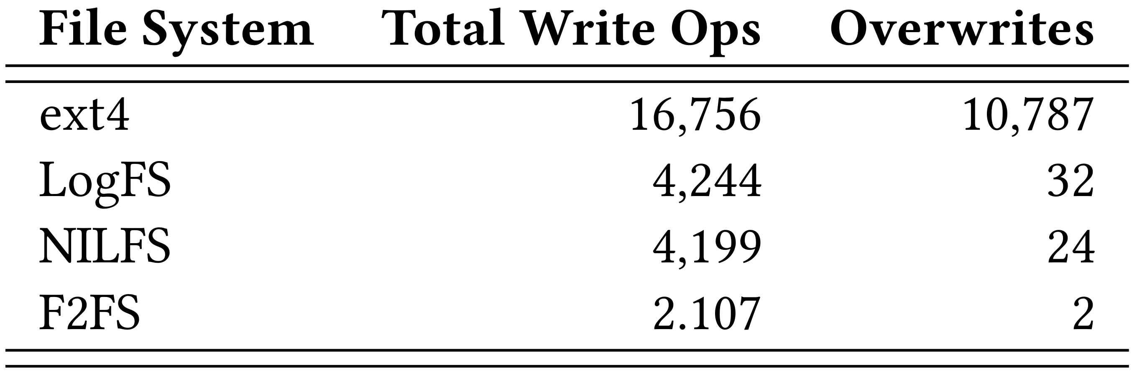
LFS Makes Few Overwrites
STRONGBOX I

Slide 51

Actively Versioning System State
TPM/TEE allows us to actively version system state
STRONGBOX I

Slide 52
Actively Versioning System State
TPM/TEE allows us to actively version system state
Accomplished with fast secure monotonic counters
STRONGBOX I

Slide 53
Actively Versioning System State
TPM/TEE allows us to actively version system state
Accomplished with fast secure monotonic counters
These hardware counters cannot be rolled back!
STRONGBOX I

Slide 54

The Grand Solution
Leveraging the trends, we proposed StrongBox
A drop-in replacement for AES-backed FDE providers such as dm-crypt
Uses a stream cipher instead of the AES-XTS block cipher
Uses an LFS to avoid overwrites and rekeying penalties
Uses secure monotonic counters to prevent rollbacks
STRONGBOX I

Slide 55
Threat Model
Confidentiality
dm-crypt (AES-XTS): AES block cipher
StrongBox: ChaCha20 stream cipher
STRONGBOX I

Slide 56
Threat Model
Confidentiality
dm-crypt (AES-XTS): AES block cipher
StrongBox: ChaCha20 stream cipher
Overwrites (many-time pad)
dm-crypt (AES-XTS): N/A
StrongBox: append-only write property of FTL/LFS
STRONGBOX I

Slide 57
Threat Model (continued)
Rollbacks
dm-crypt (AES-XTS): N/A
StrongBox: secure monotonic counters
STRONGBOX I

Slide 58
Threat Model (continued)
Rollbacks
dm-crypt (AES-XTS): N/A
StrongBox: secure monotonic counters
Integrity
dm-crypt (AES-XTS): hopefully the user is paying attention
StrongBox: hashing scheme to tie system state to counter
STRONGBOX I

Slide 59
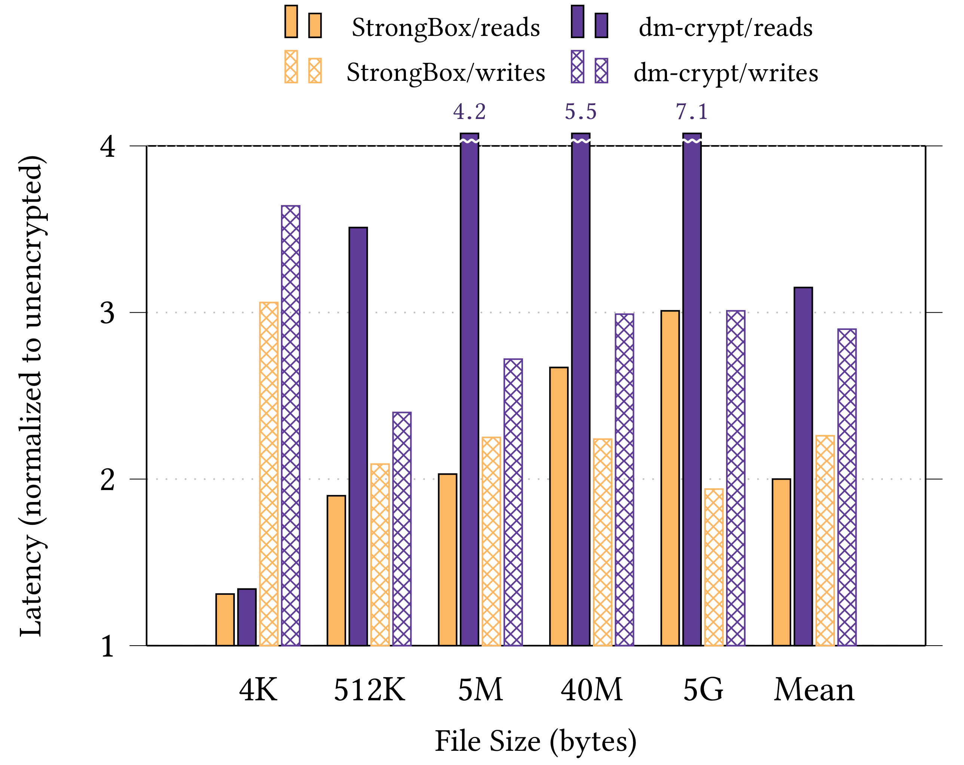
Performance Win
By harmonic mean:
1.7x faster reads
1.3x faster writes
Experimental setup:
Odroid XU3 ARM big.LITTLE system
eMMC 5.0HS400 backing store
STRONGBOX I

Slide 60
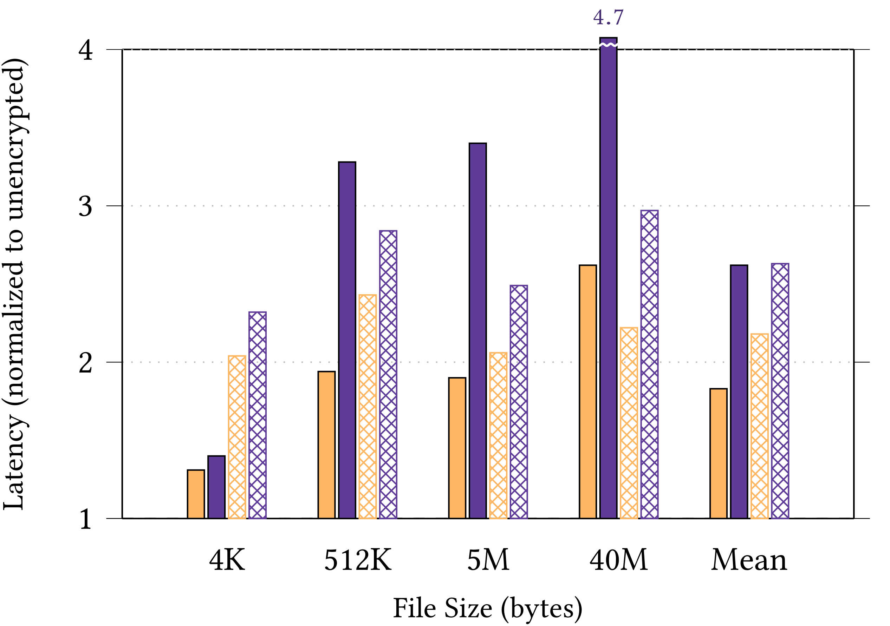
Performance Win (Random IO)
By harmonic mean:
1.7x faster reads
1.3x faster writes
Experimental setup:
Odroid XU3 ARM big.LITTLE system
eMMC 5.0HS400 backing store
STRONGBOX I

Slide 61
Hardware Accelerated AES?
What about hardware support for AES (i.e. AES-NI?)
STRONGBOX I

Slide 62
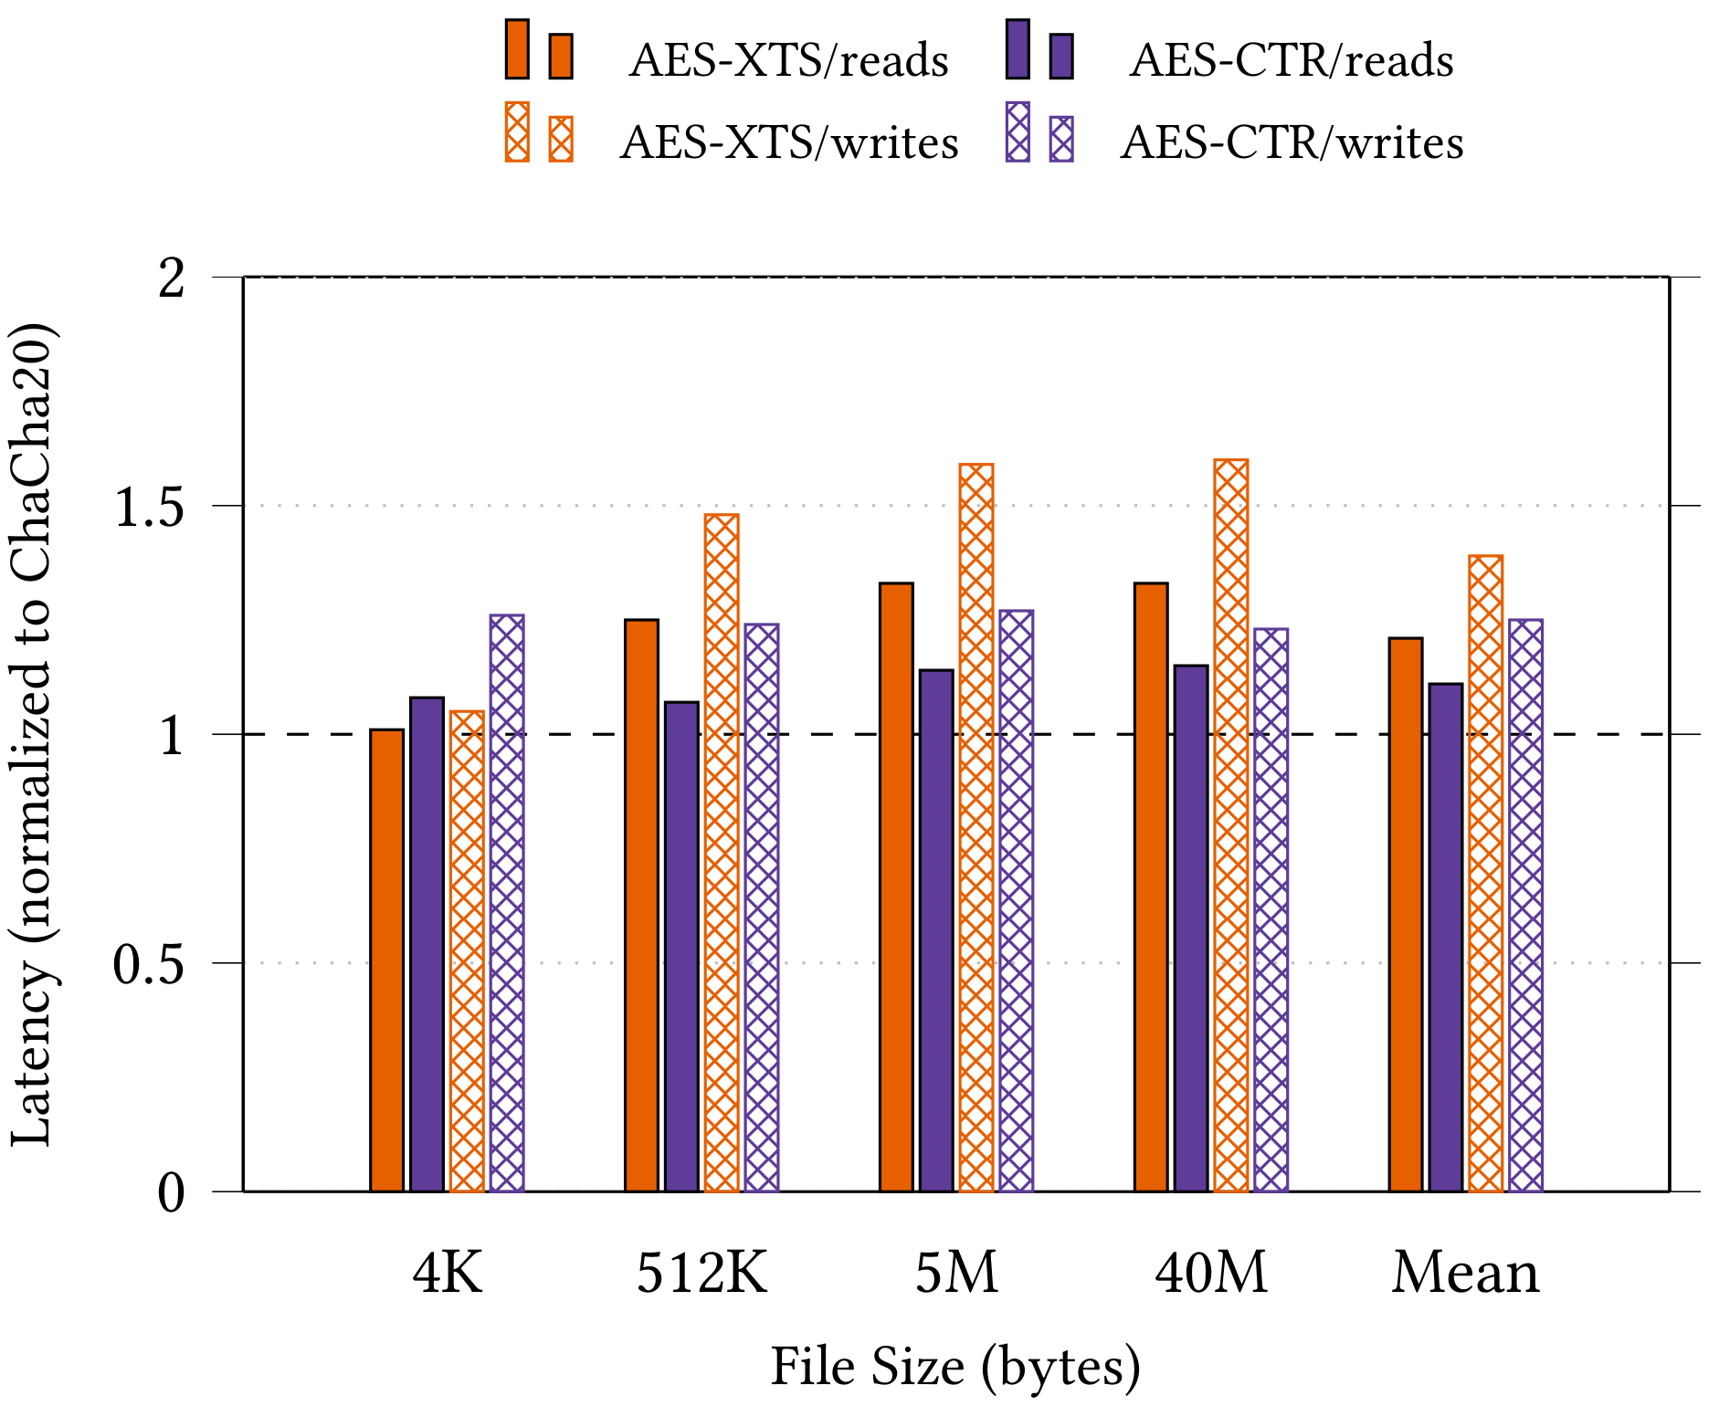
AES Block Cipher In CTR Mode
STRONGBOX I

Slide 63
How about other stream ciphers?
What can we do with ciphers other than ChaCha20?

Slide 64
STRONGBOX
StrongBox I
We update the conventional wisdom regarding FDE: stream ciphers are suitable for FDE!
We develop and implement a secure approach to FDE based on the ChaCha20 stream cipher, F2FS LFS, and RPMB eMMC trusted hardware
StrongBox II
We consider the tradeoff space and motivated use cases formed between ciphers other than just ChaCha20 (e.g. Freestyle, Rabbit, AES-CTR)
Cipher characteristics we trade off include: energy use, system perf, and security guarantees of the cipher (e.g. key length, computation time, hardness)
StrongBox III
We present a novel theoretical framework for FDE and formally evaluate the security guarantees of our constructions

Slide 65
BEYOND CHACHA20
Text
Text
STRONGBOX II

Slide 66
STRONGBOX
StrongBox I
We update the conventional wisdom regarding FDE: stream ciphers are suitable for FDE!
We develop and implement a secure approach to FDE based on the ChaCha20 stream cipher, F2FS LFS, and RPMB eMMC trusted hardware
StrongBox II
We consider the tradeoff space and motivated use cases formed between ciphers other than just ChaCha20 (e.g. Freestyle, Rabbit, AES-CTR)
Cipher characteristics we trade off include: energy use, system perf, and security guarantees of the cipher (e.g. key length, computation time, hardness)
StrongBox III
We present a novel theoretical framework for FDE and formally evaluate the security guarantees of our constructions

Slide 67
A Formal model
Text
Text
STRONGBOX III

Slide 68


INITIAL EXPERIMENTS
IMPLEMENTATION
Literature review and data gathering
6000+ LoC solution and experimental setup
SB I
✔
✔
✔
✔
THREAT MODELING
FOUNDATIONAL PAPER
SB II
Address threats to stream cipher based FDE
ASPLOS 2018
USE CASE STUDIES
CIPHER SWITCHING
Study key tradeoff use cases
Experiment with switch strategies
4/2019
✔
✔
✔
SB III
PARETO CURVES
CIPHER ABSTRACTION
Characterize tradeoff space
Rebuild StrongBox for multiple ciphers
INITIAL RESEARCH
MODEL EVALUATION
Literature review and organization
Formal assessment of security models
5/2019
6/2019
8/2019
12/2019
!
FORMALIZATION
CRYPTANALYSIS
Constructing a useful theoretical framework
Formal investigation versus e.g. XTS

Slide 69
PROJECT STRONGBOX
Questions?
BERNARD DICKENS III HENRY HOFFMANN HARYADI S. GUNAWI DAVID CASH ARIEL J. FELDMAN

